Slide 1
B2B Commerce Malaysia & Candidate Fit Analysis
Company Overview, Tools Relevance, and Candidate Evaluation

Slide 2
B2B Commerce Malaysia Overview
Leading procure-to-pay platform in Southeast Asia
Offers digital solutions for supply chain and financial operations
Trusted by over 20,000 organizations
Operates in Malaysia, Vietnam, Indonesia, Cambodia, and Thailand

Slide 3
Core Offerings
Procure-to-Pay Platform
Contract & Order Management
e-Invoicing & Financing
Inventory & Claim Management
Advanced Analytics

Slide 4
Subsidiaries
B2B Finpal: P2P financing platform licensed by Securities Commission of Malaysia
Finpal offers invoice financing and working capital loans
B2B daiGor: Cross-border e-commerce marketplace for FMCG brands
DaiGor connects 12,000+ FMCG players in SEA and 5,000+ buyers in China

Slide 5
Relevance of Pentaho
Used for ETL, data integration, and business intelligence
Supports data warehousing and predictive analytics
Enables real-time dashboards and client reporting
Helps optimize supply chain and financial insights

Slide 6
Relevance of Selenium
Automates browser testing for platforms like daiGor and Finpal
Validates user journeys and detects bugs
Supports CI/CD pipelines for quality assurance
Ensures platform stability and performance

Slide 7
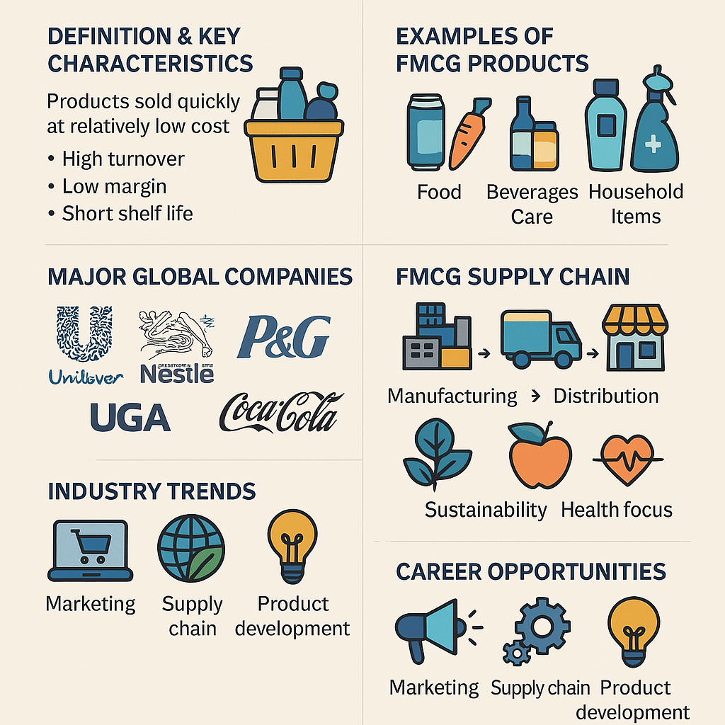
FMCG Overview

Slide 8
Pentaho vs Talend - Similarities
Both are open-source ETL and data integration tools
Support visual drag-and-drop interfaces
Compatible with big data and cloud platforms
Enable scheduling, automation, and data transformation

Slide 9
Selenium Alternatives
Playwright: Fast, modern, multi-browser support
Cypress: Developer-friendly, great for frontend testing
TestCafe: Easy setup, supports modern JS frameworks
Puppeteer: Headless Chrome automation
Katalon Studio and Robot Framework for broader testing needs

Slide 10
Candidate Overview: Mohammad Amirun Haziq
Bachelor's in Data Engineering from UTM (CGPA 3.66)
Analytics Specialist at Quandatics with ETL and BI experience
Proficient in Talend, Python, SQL, and data visualization tools
Worked with clients like TM, UMobile, DOE Philippines

Slide 11
Why He’s a Strong Fit for ETL Support Engineer
Hands-on experience with Talend (Standard, Big Data, Streaming)
Proficient in Python, SQL, and relational databases
Experience with cloud platforms, Jenkins, Docker, and TAC API
Conducted UAT, SIT, and liaised with clients for issue resolution
Certified in Power BI, Azure, IBM Data Engineering, and more

